Slide 1

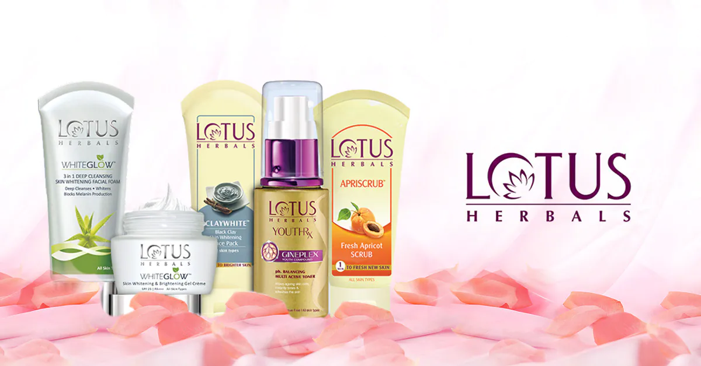
Balanced scorecard slide 1
Market Research Project
Presented by Group - 6

Slide 2
Objectives
Research Design
Incidence of Sunscreen
Usage and Purchase Behaviour
Brand Health Analysis
Conclusion
Agenda

Slide 3



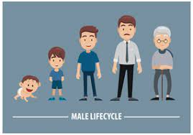
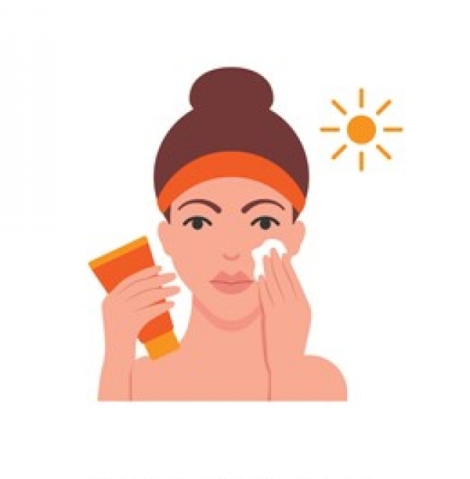
Objective
1
2
3
Target Group
To study the incidence of sunscreen as a product category
To find purchase and usage habits among sunscreen users
To study the brand health of different sunscreen brands and lotus herbal
Male
Female
Age :18-35
Sampling method:
Simple Random sampling
Snowball sampling
Research design:
Primary survey
Computation: excel
Usage: 5 times a week or daily

Slide 4
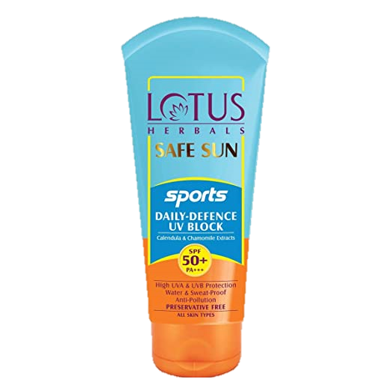
Balanced scorecard slide 5
Age group
Location
Gender
Below 18: 2%
Kolkata: 56.5%
Male: 54.1%
Other parts of West Bengal:16.6%
Female: 45.1%
18-23: 47.2%
Other eastern states: 6.9%
Other: 0.8%
24-29: 38.2%
Rest of India: 19.9%
30-35: 11.4%
36 and above: 1.2%
Sample

Slide 5
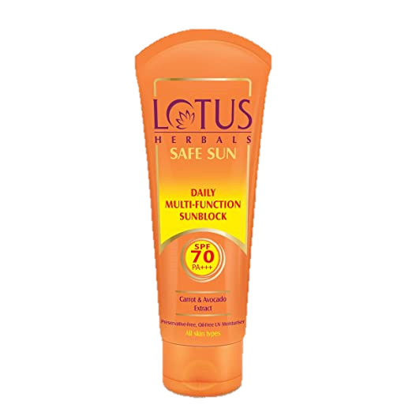
Balanced scorecard slide 5
Incidence of Sunscreen
Product Penetration: 60.2%
Age group
Location
Gender
Below 0%
Kolkata: 65.5%
Male: 79.3%
18-23: 67.2%
Other parts of West Bengal: 63.4%
Female: 48.9%
24-29: 60.6%
Other eastern states: 64.7%
Other: 50%
Rest of India: 53.1%
30-35: 67.9%
36 and above: 0%

Slide 6
Usage and Purchase Behaviour
Gender wise
Once/twice a week Thrice/four times week Five times a week Daily
Male: 32.3% 13.9% 18.5% 35.4% Female: 12.5% 6.8% 31.2% 48.9%
Others: 100%
Usage of Sunscreen
Women are more frequent users of sunscreen than men and others.
Age wise
Once/twice a week Thrice/ four times week Five times a week Daily
18-23: 24.9% 8.9% 29.5% 37.2%
24-29: 21.1% 10.4% 24.4% 43.3%
30-35: 10.5% 10.5% 15.8% 63.2%
The youngest and the middle age people are the regular users of sunscreen.

Slide 7
Purchase Location
Age Kirana Modern Format E-Commerce
18-23: 6.6% 19.8% 46.2% 24-29: 23% 23% 54%
30-35: 13.3% 46.7% 40%
Majority of people among different age groups prefer purchasing of sunscreen through modern format & e-commerce.
SKUs Place of Purchase
SKU Kirana Modern Format E-Commerce
Cream: 15.8% 34.2% 50%
Lotion: 20% 45% 35%
Gel based: 25% 12.5% 62.5%
Spray: 0% 50% 50%
No matter whatever the SKU is, people prefer buying it either from modern format or e-commerce
Income influence over purchase behavior
SPF 15+ SPF 30+ SPF 50+
Student: 16.7% 34.8% 48.5%
Salaried: 39.1% 17.4% 43.5%
Self-employed: 16.7% 33.3% 50%
Others: 0% 50% 50%
Income of individuals doesn't affect the SKUs buying behavior of customers.

Slide 8
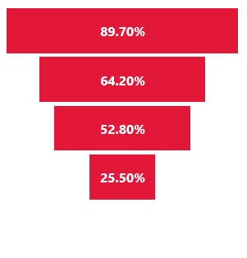
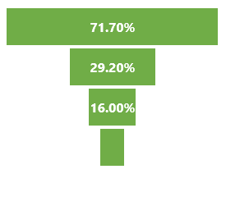
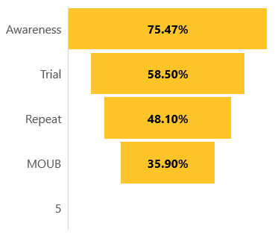
Brand Health Analysis
Awareness
Awareness | Lotus Herbals | Lakme | VLCC
TOM | 28.6% | 23.4% | 15.4%
Aided | 75.5% | 80.2% | 58.5%
Lotus Herbals
Lakme
VLCC
Brand Funnel
8.5 %

Slide 9
Ratios
 | Lotus Herbals | Lakme | VLCC
Trial/Awareness | 77.51% | 71.57% | 40.73%
Repeat/Trial | 82.22% | 82.24% | 54.79%
MOUB/ Repeat | 74.63% | 48.29% | 53.13%
Brand Loyalty
 | Lotus Herbals | Lakme | VLCC
Loyalty (based on purchase habit) | 86.8% | 77.8% | 77.8%
Loyalty (based on recommendations) | 87.9% | 88.9% | 88.9%

Slide 10
Brand Image Analysis
 | Lotus Herbals | Lakme | VLCC
 | % | % | % | Mean
Moisturized skin. | 52.83% | 56.60% | 35.85% | 48.43%
Oil-free skin. | 47.17% | 46.23% | 31.13% | 41.51%
Quickly absorbable. | 53.77% | 52.83% | 33.02% | 46.54%
Sun protection. | 56.60% | 58.49% | 44.34% | 53.14%
Irritation free. | 57.55% | 53.77% | 41.51% | 50.94%
Prevents facial redness. | 52.83% | 41.51% | 40.57% | 44.97%
Mean | 53.46% | 51.57% | 37.74% | 47.59%
Lotus Herbals is almost equally liked for the different attributes.
 | Lotus Herbals | Lakme | VLCC
Moisturized skin. |  | ++ | --
Oil-free skin.
Quickly absorbable. |  | + | --
Sun protection. | -
Irritation free.
Prevents facial redness. | + | -- | ++
Lotus Herbals doesn’t look like to have a competitive advantage over other brands in terms of attributes.

Slide 11
Multiple Regression Analysis
Regression Statistics
Multiple R | 0.583375198
R Square | 0.340326621
Adjusted R Square | 0.300346416
Standard Error | 0.885197321
Observations | 106
ANOVA
 | df | SS | MS | F | Significance F
Regression | 6 | 40.02048427 | 6.670081 | 8.512378138 | 1.85323E-07
Residual | 99 | 77.57385535 | 0.783574
Total | 105 | 117.5943396
 | Coefficients
Intercept | 1.661810155
Moisturized skin. | 0.382769446
Oil-free skin. | 0.102011041
Quickly absorbable. | -0.043909452
Sun protection. | 0.094611403
Irritation free. | -0.10539541
Prevents facial redness. | 0.168868839
P-value
4.63043E-06
0.004086452
0.417921695
0.743071647
0.568925728
0.409339988
0.340321655
Adjusted R Square is very small value.
Significant F-value.
Only one attribute i.e. moisturized skin is influencing the overall preference of Lotus Herbals.
Significant intercept means other unknown factors are influencing the overall preference.
Regression equation:
Overall Preference = 1.66 + 0.38*Moisturized skin

Slide 12
Bi-variate Regression Analysis
Regression Statistics
Multiple R | 0.559351018
R Square | 0.312873562
Adjusted R Square | 0.306266577
Standard Error | 0.88144429
Observations | 106
ANOVA
 | df | SS | MS | F | Significance F
Regression | 1 | 36.79215987 | 36.79216 | 47.35496787 | 4.59219E-10
Residual | 104 | 80.80217976 | 0.776944
Total | 105 | 117.5943396
Adjusted R Square increased here means there were more number of junk variables in case of multiple regression.
Significant F-value.
Moisturized skin is positively influencing the overall preference of Lotus Herbals.
Significant intercept means other unknown factors are influencing the overall preference.
Regression equation:
Overall Preference = 1.86 + 0.54*Moisturized skin
 | Coefficients | P-value
Intercept | 1.855927142 | 1.02415E-08
Moisturized skin. | 0.539564049 | 4.59219E-10

Slide 13
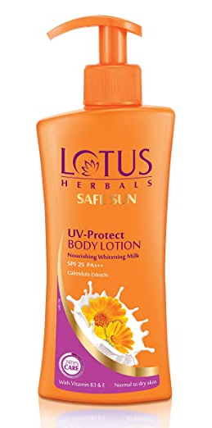
Conclusion
Product Category:
Sunscreen has moderate penetration.
Sunscreen is almost equally popular among male and female, younger and middle age people.
Usage frequency is high.
People buy sunscreen either from modern format store or from e-commerce.
Lotus Herbals:
Awareness of Lotus Herbals is lesser than that of Lakme.
Trail, Repeat and MOUB is quite high.
High brand loyal customers.
Prevention of facial redness is the strength and sun protection is the weakness.

Slide 14
Thank You

